Slide 1
Hempler’s May ‘25 Snapshot
May 5th, 2025

Slide 2
YTD Snapshot
01
April Snapshot
02
April Line-Item Insights
03
April Keyword Insights
04
April Category Insights
05
Pacing Report
06

Slide 3
Hemplers: YTD ’25 SNAPSHOT
Criteo sponsored products
Campaign Dates: January 1st, 2025 - May 31st 2025
Snapshot Dates: January 1st, 2025 – April 30th, 2025
Overview
Total Budget | Optimizer
$95,000 | Revenue (ROAS)
Campaign
Details
50,744,241
61,972
$66,756
$317,666
33,838
$1.08
$4.76
Impressions
Clicks
Spend
Revenue
Units Sold
CPC
ROAS
Hemplers drove $317,666 in revenue on $66,756 in spend so far in 2025.
Avg cap out Hour: 9:00 PM EST

Slide 4
Hemplers: APRIL ’25 SNAPSHOT
Criteo sponsored products
Campaign Dates: January 1st, 2025 - May 31st 2025
Snapshot Dates: April 1st, 2025 - April 30th, 2025
Overview
Total Budget | Optimizer
$95,000 | Revenue (ROAS)
Campaign
Details
13,064,384
12,445
$18,104
$73,501
6,639
$1.45
$4.06
Impressions
Clicks
Spend
Revenue
Units Sold
CPC
ROAS
Hemplers drove $73,501 in revenue on $18,104 in spend in April.
Avg cap out Hour: 5:00 PM EST

Slide 5
Hemplers: APRIL ’25 LINE ITEMS
Criteo sponsored products
Line-Item | Impressions | Clicks | Spend | Sales | Units | Avg. CPC | ROAS | Capout Hour
Hempler's Foods Group LLC_Hemplers_1H 2025_SPA_PM-MS__Meat_Hempler's Bacon | 13,064,384 | 12,445 | $18,104 | $73,337 | 6,617 | $1.45 | $4.05 | 5:00 PM EST
Key Takeaways
The Iserno’s line-item turned off in late March, leaving only Bacon to spend through April.
With increased spend, bacon ROAS dropped slightly down to $4.
Strong capout time at 5pm EST.

Slide 6
Hemplers: APRIL ’25 KEYWORDS
Criteo sponsored products
Keyword | Impressions | Spend | Sales | ROAS
bacon | 428,090 | $9,867 | $40,935 | $4.15
bacon cut thick | 9,158 | $568 | $2,597 | $4.57
bacon turkey | 9,860 | $371 | $495 | $1.33
bacon beef | 5,273 | $341 | $91 | $0.27
bacon canadian | 14,334 | $290 | $701 | $2.42
bacon uncured | 1,365 | $180 | $807 | $4.46
bacon hemplers | 1,332 | $129 | $635 | $4.92
bacon center cut | 509 | $113 | $499 | $4.42
bacon thick | 1,707 | $90 | $497 | $5.47
bacon pepper | 451 | $84 | $435 | $5.13
bacon deal | 4,948 | $83 | $128 | $1.54
bacon organic | 879 | $72 | $440 | $6.11
bacon cook | 5,700 | $71 | $153 | $2.14
hemplers | 2,240 | $65 | $379 | $5.84
bacon free nitrate | 219 | $41 | $104 | $2.54
Note:
This is only inclusive of search placements, which is not 100% of spend. SPA also delivers on category, checkout, PDP, and home pages, which require no keywords

Slide 7
Hemplers: APRIL ’25 CATEGORIES
Criteo sponsored products
Category | Impressions | Spend | Sales | ROAS | ROAS Benchmark
Bacon | 13,053,565 | $18,073 | $73,218 | $4.05 | $4.86
Key Takeaways
Bacon fell slightly under the category benchmark in the month of April due to budget fluctuations.
In the first 5 days of May, ROAS is back to ~$4.30. Will continue to drop bids to get this to the category benchmark!

Slide 8
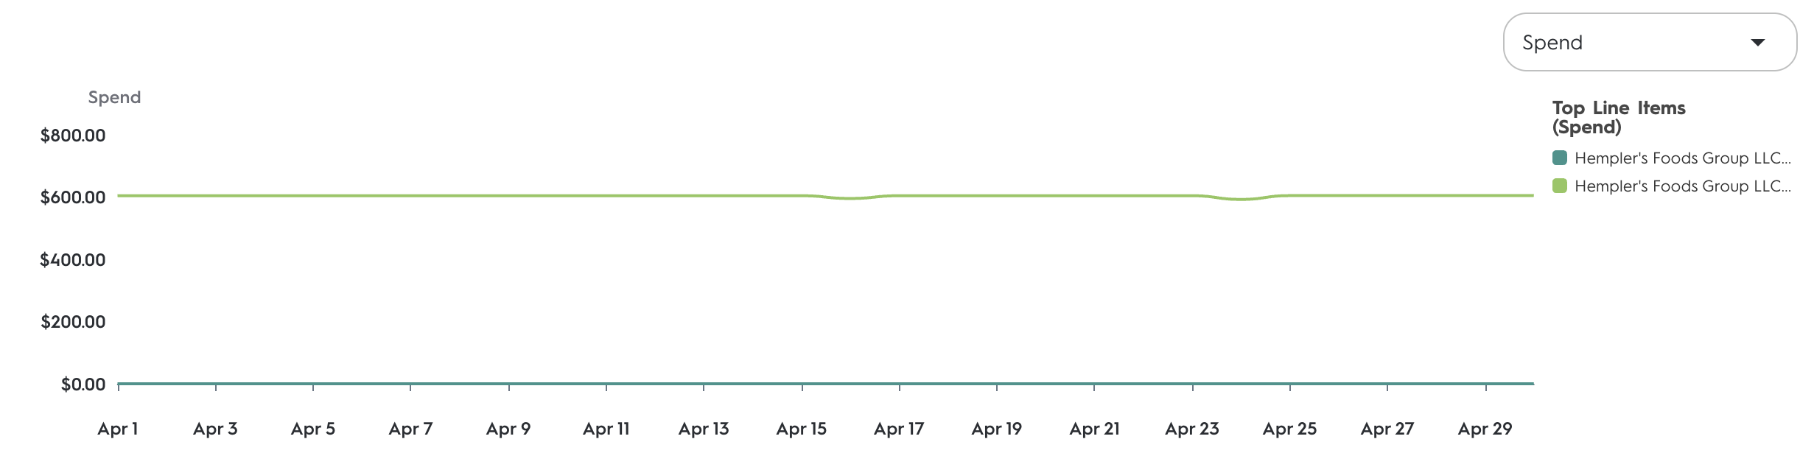
Hempler’s: PACING REPORT
Criteo sponsored products
Strategy
Campaign | % Of Flight Date | % Of Budget Spent | Pacing Relative To Budget
Bacon | 72% | 69% | -3%
Key Takeaways
The bacon line-item has been capping out every day resulting in strong pacing. The campaign is likely to deliver in full by end of H1. The Franks + Sausages line-item kicked in on May 1st!

